Slide 1
Pengantar Kuliah Visi Komputer
Gasal 2019 – 2020
Pengajar: Nanik Suciati

Slide 2
Referensi
Richard Szeliski, Computer Vision: Algorithms and Applications
Rafael C. Gonzalez dan Richard E. Woods, Digital Image Processing
Joseph Howse, Prateek Joshi, Michael Beyeler, OpenCV: Computer Vision Projects with Python
Alexander Mordvintsev & Abid K, OpenCV-Python Tutorials: Documentation

Slide 3
What is computer vision?
Image processing
Vision
Geometry (3D)
shape
Image (2D)
Graphics

Slide 4
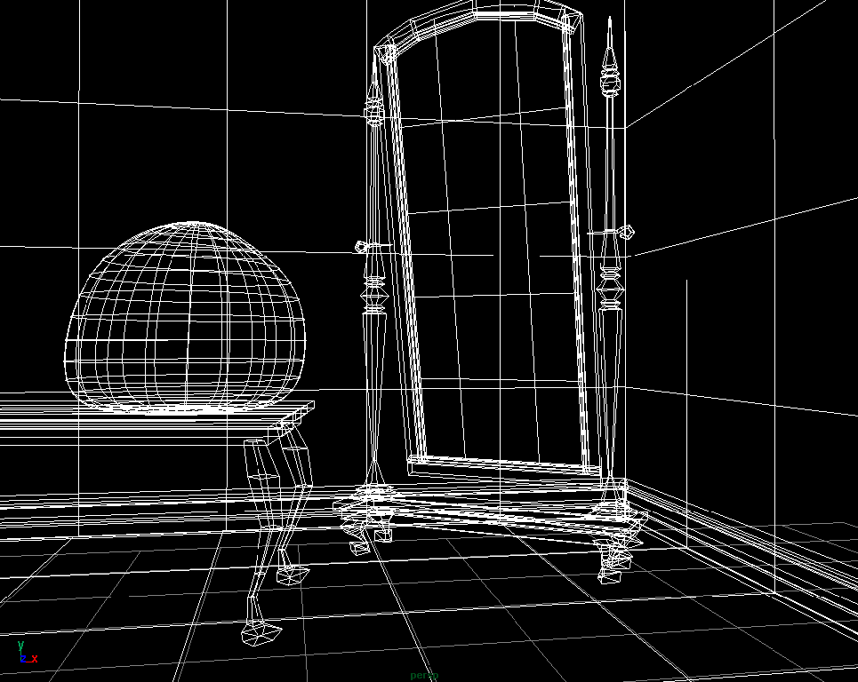
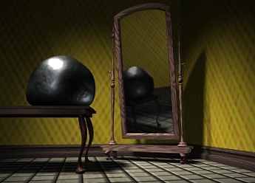
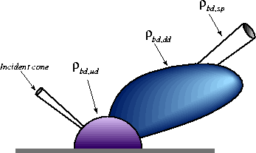
What is computer graphics? (3D->2D)
3D geometry
projection
Simulation
physics
GRAPHICS

Slide 5
What is computer vision? (2D->3D)
3D geometry
Estimation
Other useful information …
physics

Slide 6
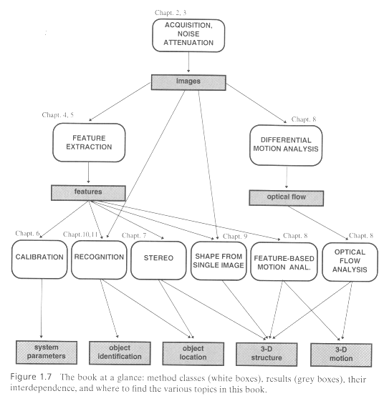
Computer Vision [Trucco&Verri’98]

Slide 7
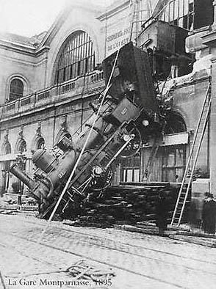
Every picture tells a story
Goal of computer vision is to write computer programs that can interpret images

Slide 8
Can computers match (or beat) human vision?
Yes and no (but mostly no!)
humans are much better at “hard” things
computers can be better at “easy” things
Notes:
If you can write a formula for it, computers can excel
Computer vision can’t solve the whole problem (yet), so breaks it down into pieces.
Many of the pieces have important applications.

Slide 9
Current state of the art
The next slides show some examples of what current vision systems can do

Slide 10
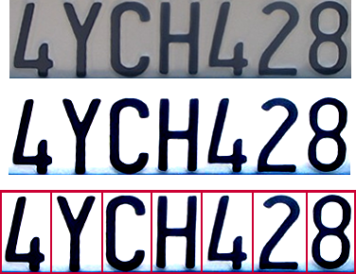
Optical character recognition (OCR)
Technology to convert scanned docs to text
If you have a scanner, it probably came with OCR software
Digit recognition, AT&T labs
http://www.research.att.com/~yann/
License plate readers
http://en.wikipedia.org/wiki/Automatic_number_plate_recognition

Slide 11
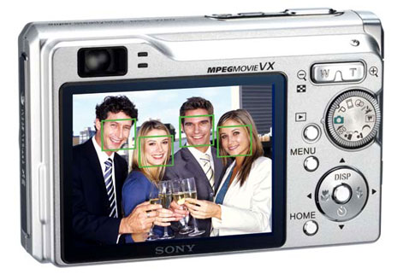
Face detection
Many new digital cameras now detect faces
Canon, Sony, Fuji, …
Notes:
Why would this be useful? Main reason is focus. Also enables “smart” cropping.

Slide 12
Smile detection?
Sony Cyber-shot® T70 Digital Still Camera

Slide 13
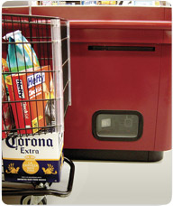
Object recognition (in supermarkets)
LaneHawk by EvolutionRobotics
“A smart camera is flush-mounted in the checkout lane, continuously watching for items. When an item is detected and recognized, the cashier verifies the quantity of items that were found under the basket, and continues to close the transaction. The item can remain under the basket, and with LaneHawk,you are assured to get paid for it… “

Slide 14
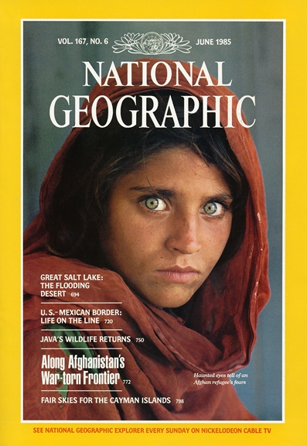
Face recognition
Who is she?

Slide 15
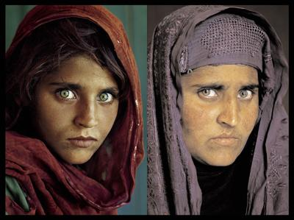
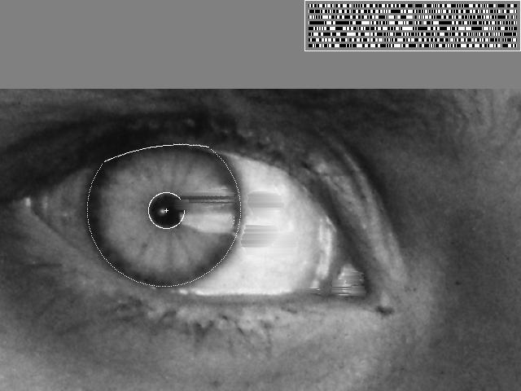
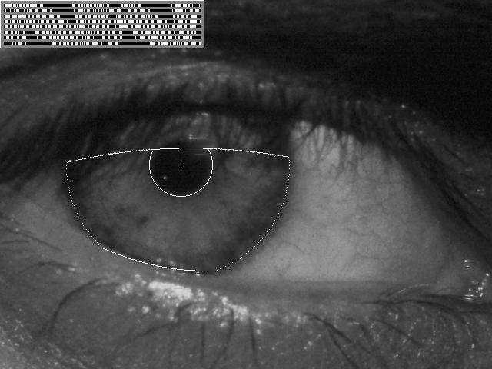
Vision-based biometrics
“How the Afghan Girl was Identified by Her Iris Patterns” Read the story

Slide 16
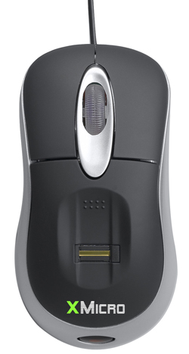
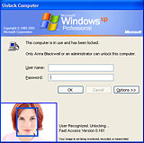
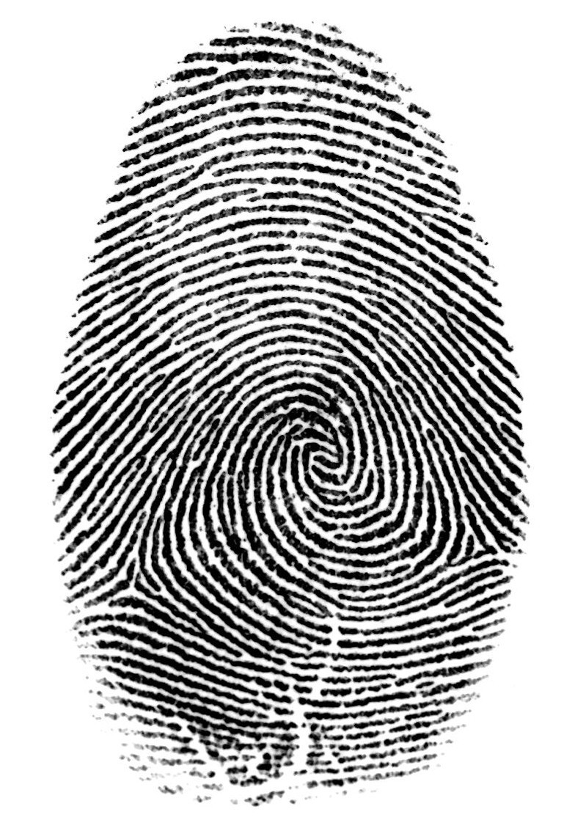

Login without a password…
Fingerprint scanners on many new laptops, other devices
Face recognition systems now beginning to appear more widely http://www.sensiblevision.com/

Slide 17
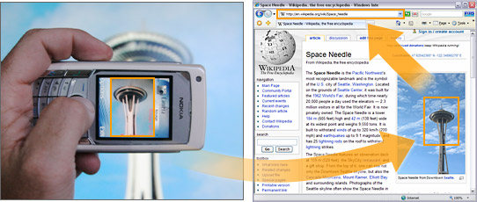

Object recognition (in mobile phones)
This is becoming real:
Microsoft Research
Point & Find, Nokia

Slide 18
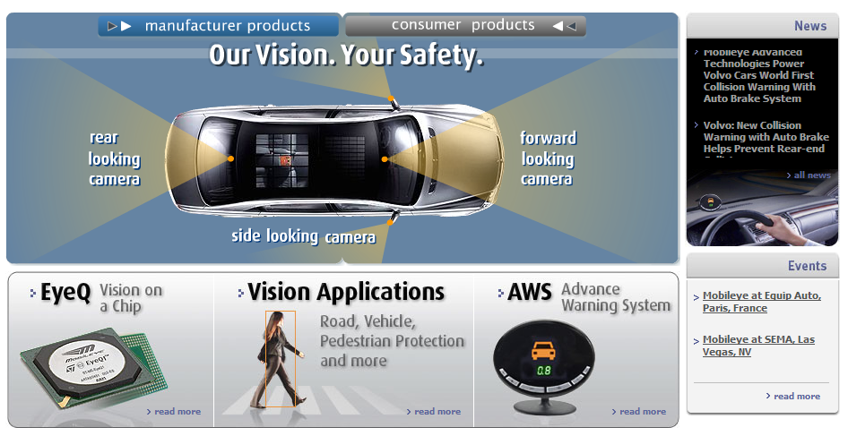
Smart cars
Slide content courtesy of Amnon Shashua
Mobileye
Vision systems currently in high-end BMW, GM, Volvo models
By 2010: 70% of car manufacturers.
Video demo

Slide 19
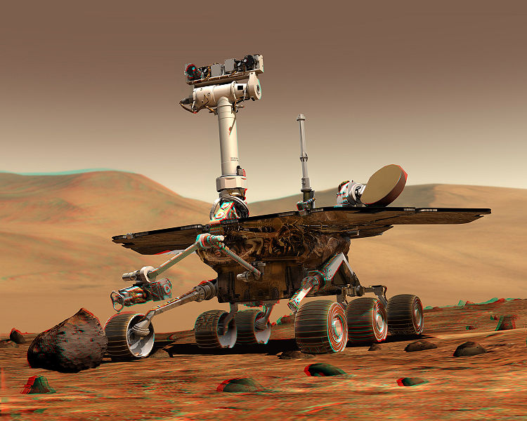
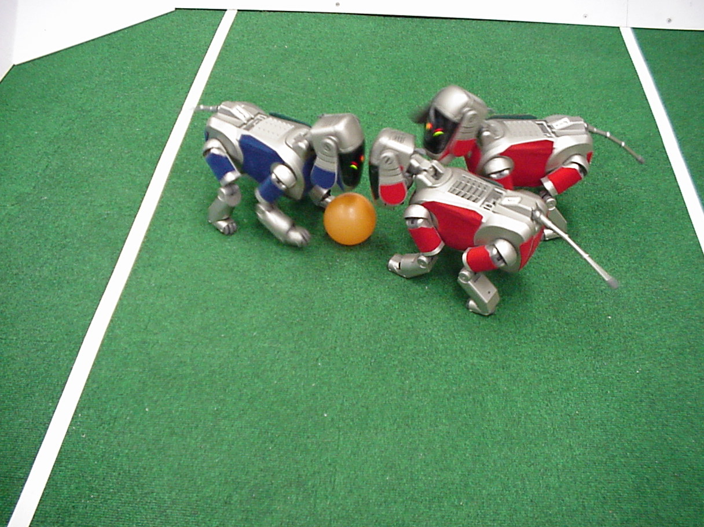
Robotics
NASA’s Mars Spirit Rover
http://en.wikipedia.org/wiki/Spirit_rover
http://www.robocup.org/

Slide 20
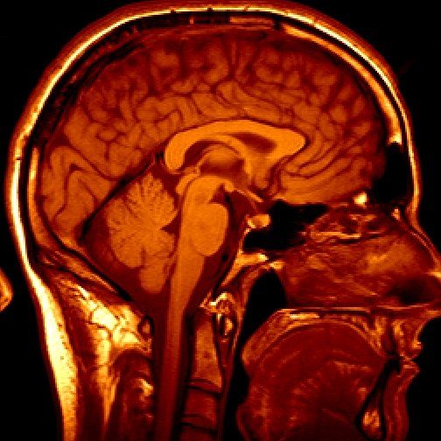
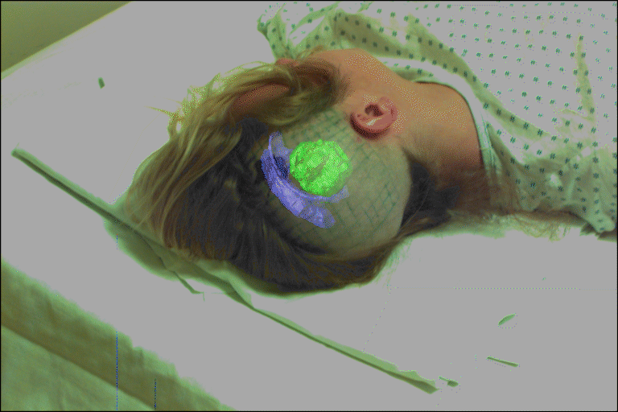
Medical imaging
3D imaging
MRI, CT
Image guided surgery
Grimson et al., MIT

Slide 21
Current state of the art
You just saw examples of current systems.
Many of these are less than 5 years old
This is a very active research area, and rapidly changing
Many new apps in the next 5 years
To learn more about vision applications and companies
David Lowe maintains an excellent overview of vision companies
http://www.cs.ubc.ca/spider/lowe/vision.html

Slide 22
Vision System
“Image recognition” and “3D object reconstruction from image” are part of vision applications → focus of this course
Preprocessing
Image or set of images
Recognition/ Reconstruction result
Feature extraction
Recognition/ Reconstruction

Slide 23
Materi Kuliah
Introduction
Preprocessing
Segmentation
Feature extraction
Classification

Slide 24
Evaluasi
Tugas:
Tugas 1 → 10%
Tugas 2 → 20%
Tugas 3 → 20%
ETS → 20%
Final Project → 30%

Slide 25
Break --- Some videos of vision app

Slide 26
PR → Dikumpulkan paling lambat hari Senin, 2 September 2019
Lakukan pencarian informasi tentang aplikasi visi komputer yang telah/sedang dikembangkan saat ini. Tulis satu contoh aplikasi visi. Laporan berisi:
PPT (maksimum 10 slide, berisi judul, overview aplikasi (input, output, teknologi), tahapan utama dalam pengembangan aplikasi, referensi.
Video atau link website tentang aplikasi visi yang ditulis
Tiap kelompok beranggotakan 4 orang

